Slide 1

Fiori@Bosch
SAP Fiori for S/4Hana
Sabrina Li Oct. 2020
Confidential

Slide 2
Content
Introduction good UX & Fiori
SAP Fiori Design Principles
SAP Fiori 2.0
SAP Fiori Launchpad
S/4HANA Architecture
Q&A
2

Slide 3
What is good UX?
A good user experience simplifies everything
-- the user interface (UI), the interaction, and
the functionality – and tailors them to seamlessly
to what you need and want for the tasks relevant
to your job.
https://videos.cdn.sap.com/vod/2015/ext/what-is-a-good-user-experience.mp4
3
Notes:
UI是UX里的一个小分支。 UI(User Interface)，是指用户界面，是视觉呈现来提高用户体验，使用户面对这个界面时操作更简单、更愉悦、更高效； UX(user experience)，就是指用户体验，单纯说用户体验是个很虚的词，我们不如说说哪些方面会影响到用户体验？ 用户使用产品（软件、硬件、电视、洗衣机等等都是产品）的目标是完成一个目标，就是去做一件事，每个人去做都希望：不要花太长时间、不要太复杂、不要让我想太多、不要弄得我不愉快、不要弄得我很紧张（焦虑）。反过来，影响这些因素的产品形态有：合理高效的流程、友好体贴的语言、操作容易理解、按键出现及时、界面舒适、不要太多无关内容影响（界面有效性）等等。 UI设计的过程，几乎渗透到UX的每一个节点，但更多的是去配合UX。比如一个界面，不考虑UX，也许UI做出来功能重点就不那么中肯。

Slide 4
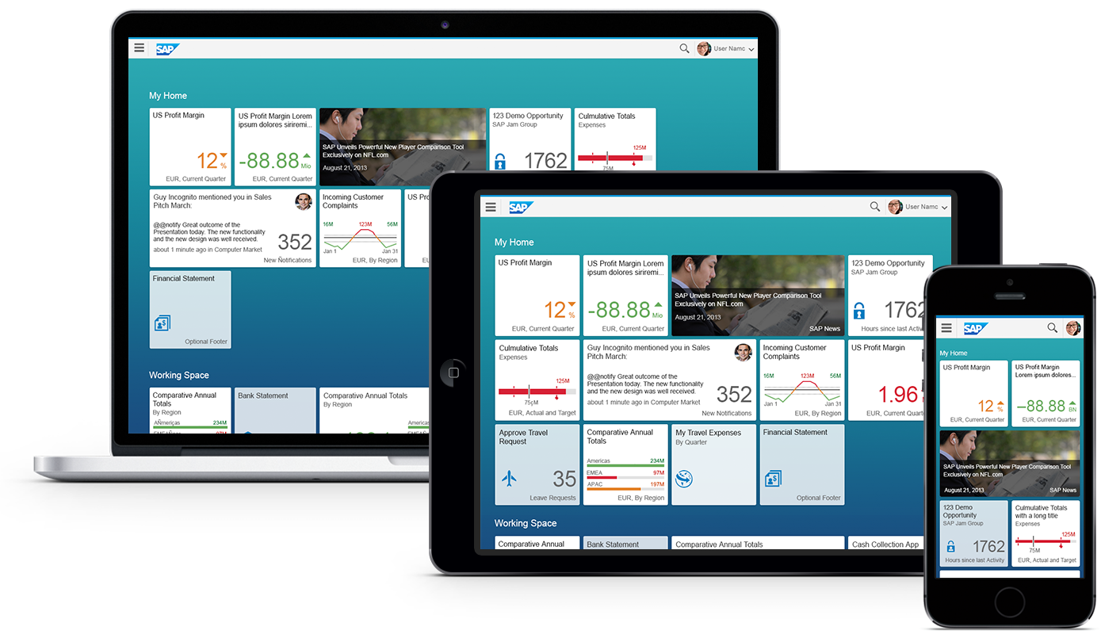
Introducing SAP Fiori Keeping Simple Things Simple
SAP Fiori is the new user experience (UX) for SAP software. It applies modern design principles for a completely reimagined user experience.
SAP Fiori UX is the new face of SAP to business users in all lines of business across devices and deployment options. It provides optimal usability for simplified business interactions and easy of use.
https://videos.cdn.sap.com/vod/2015/ext/what-is-sap-fiori.mp4
4

Slide 5
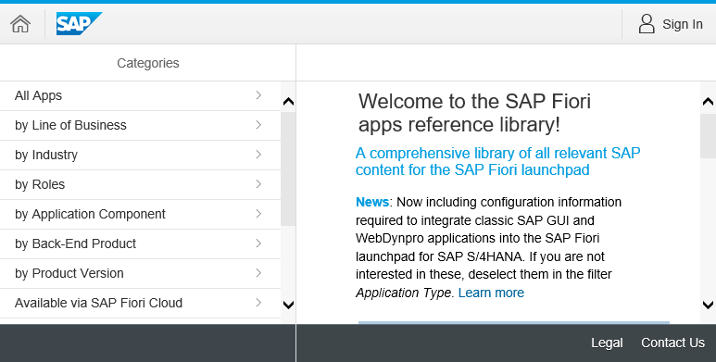
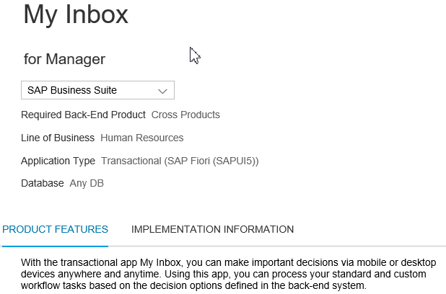

SAP Fiori App Library
General Information
User Role and LoB
Backend Requirements (HANA/AnyDB)
Search apps by various categories and filters
?
SAP Fiori App Library
Contain Information for ~1398 SAP Fiori apps for S/4HANA (Jun/2019)
Product features
Key Features
Screenshots
Related apps
Implementation Information
Version History
Installation Details
Configuration & Customizing
Extensibility
Support (Notes & App Component)

Slide 6






SAP Fiori UX Design Principles
Role-based
Responsive
Simple
Coherent
Delightful
Designed for you, your needs and how you work
Supports how and where you work, at any time
Focuses on the important
Provides one fluid, seamless experience
Makes an emotional connection
6

Slide 7


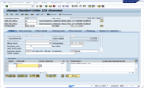
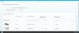
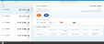
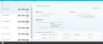
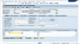
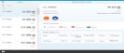
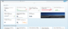
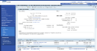
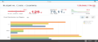
Fiori Apps Designed for Specific Roles Apps providing the right info for the right role
Functional-based applications
SAP Fiori Design Role-based applications
One transaction for multiple roles exposing all data & functions to all users
Decomposed apps for each role exposing only relevant data & functions
Multiple entry points for the user and inconsistent user experience (e.g. ERP vs. CRM)
One entry point for the user and UX following common design directions
7

Slide 8
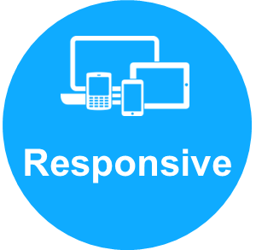
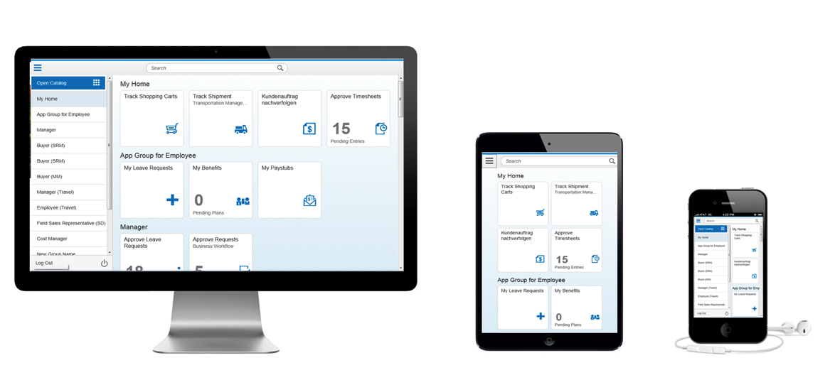
Responsive Web Design Seamless User Experience
Responsive design detects the user’s screen size and orientation to
change the layout accordingly to provide a consistent experience across devices
Benefits
Apps adapt and adjust automatically to the respective screen size based on the users device
Easy navigation and reading with a minimum of resizing, panning, and scrolling
Consistent experience across all device types
8

Slide 9

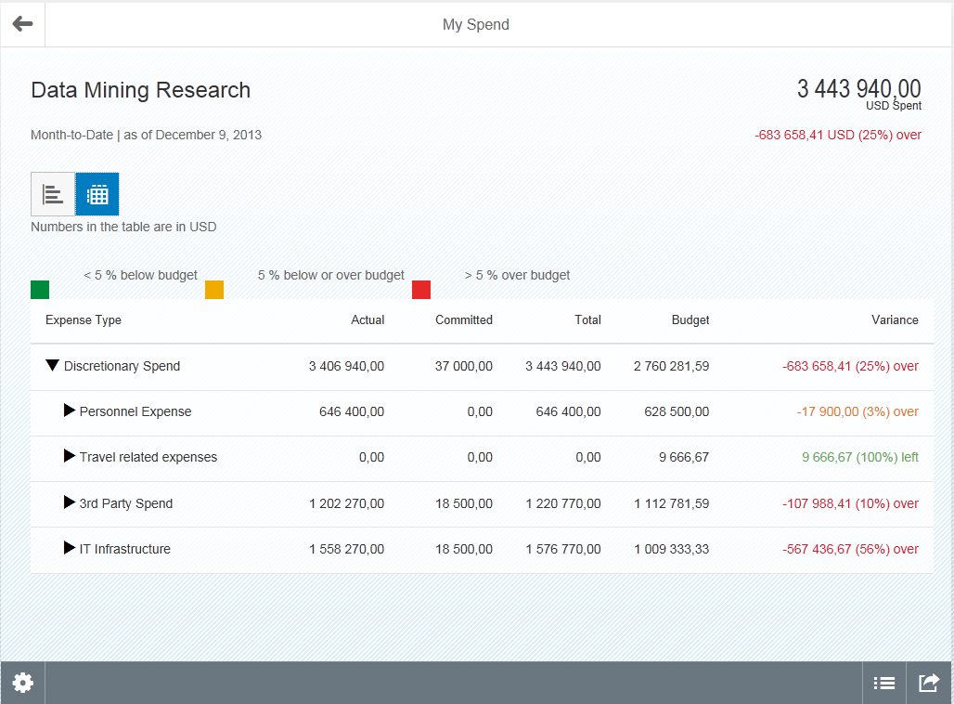
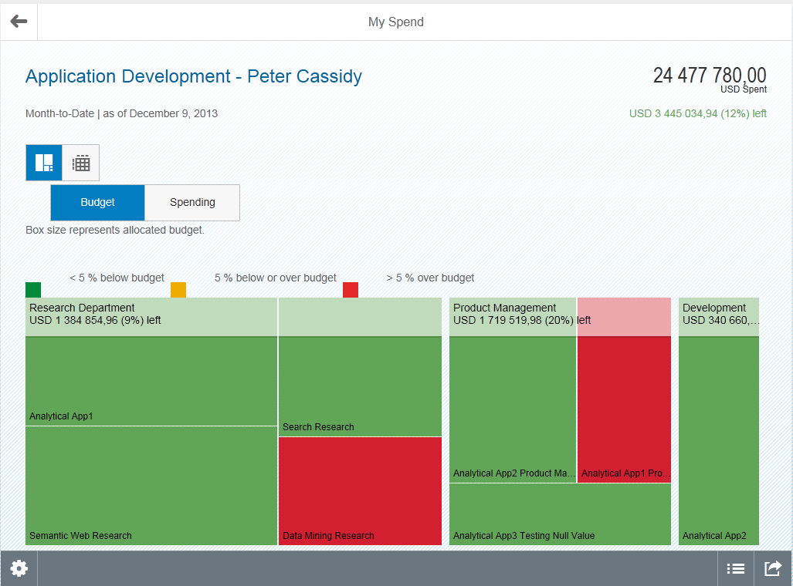
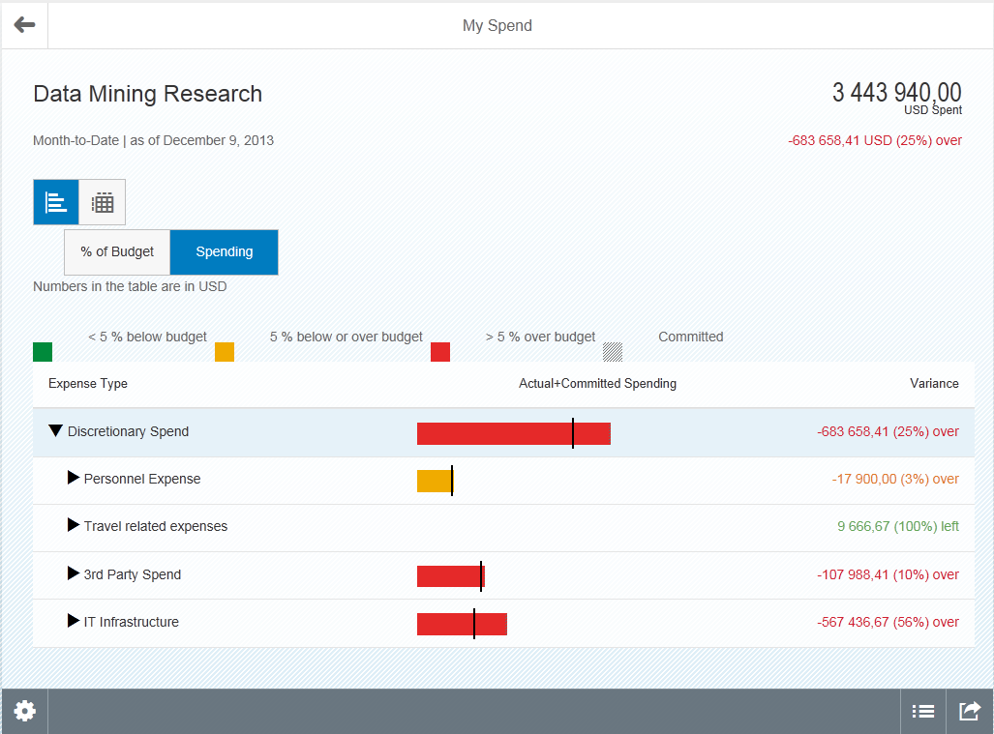
Fiori helps increase productivity: Adequate Context Information to make the Right Decision
1-1-3 scenario-- This means 1 user, 1 use case and 3 screens.
Capabilities:
Adequate context information to make the right decision
Based on user research, SAP has determined which/ how much information is required to make decision
Drill down capabilities, analysis down to a detailed level
Benefits:
Enables user to take make decisions (approve/decline) without additional iterations or research
Enables user to take corrective measures in time
9

Slide 10

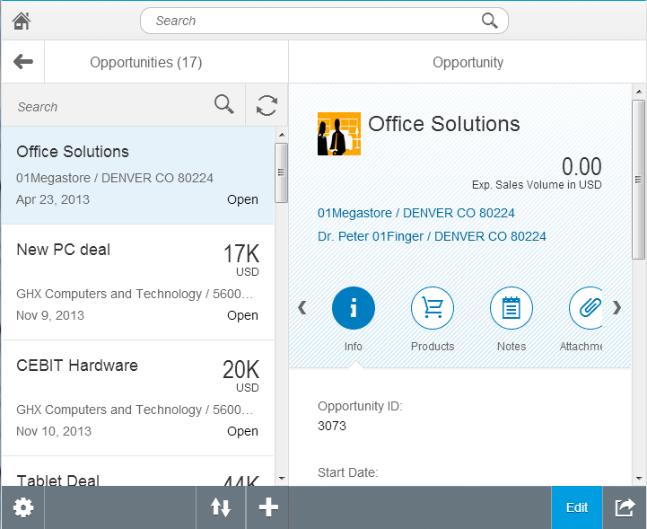
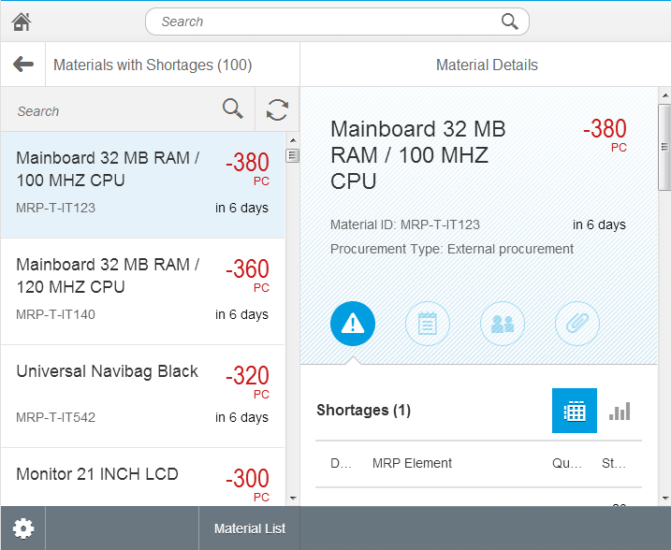
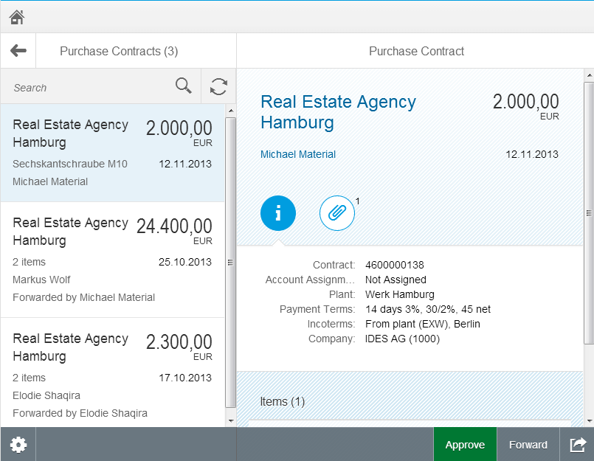
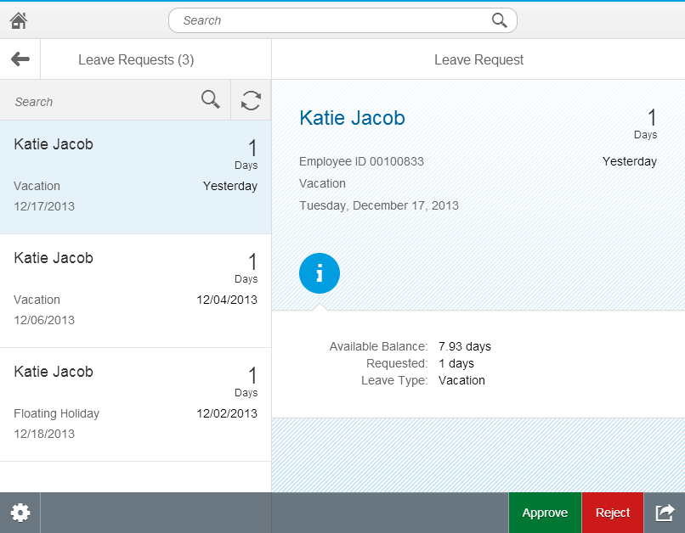
Fiori helps increase productivity: Consistent UI Across App
Sales
Capabilities:
Consistent experience across all apps, same structure, icons, etc.
Provides an optimal user experience across all device types
Benefits:
Users can switch across apps without effort
Accelerates task execution
Different Apps – Same Great Experience!!
Manufacturing
Purchasing
HCM
HCM Workflows
10

Slide 11

SAP Fiori UX Design Principles Delightful
Delightful
Make an emotional connection
Make me better at my job and feel like I’m an expert.
Show me the impact of my contribution.
Go beyond what’s expected; amaze me!
Be smart and proactive. Give me an assistant not just a tool.
“Beyond the expected”
11

Slide 12
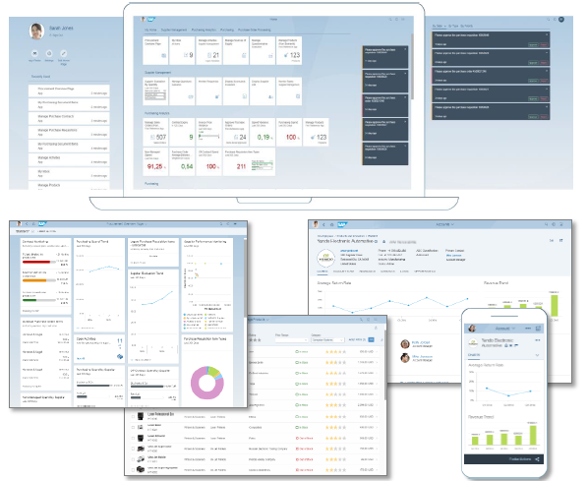
SAP Fiori 2.0
SAP Fiori 2.0 is the significant step in our evolution of user experience for business applications: an award-winning new design concept along with a delightful new visual theme, called Belize. SAP Fiori 2.0 is the user experience for SAP S/4HANA and other solutions.
Benefits
•Increased productivity –faster and direct access to relevant information and applications.
•Transparency on items needing your attention –timely notifications.
•Helps users decide what needs to be done next.
•Allows users to take quick and informed actions.
•Increased user satisfaction
Watch video of SAP Fiori 2.0 with SAP S/4HANA 1610
12

Slide 13
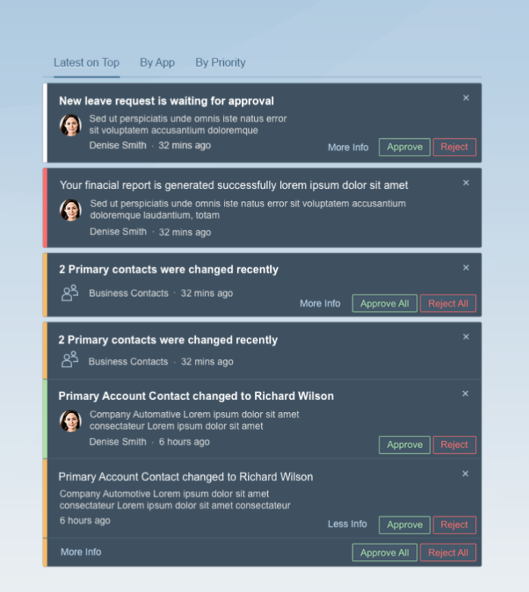
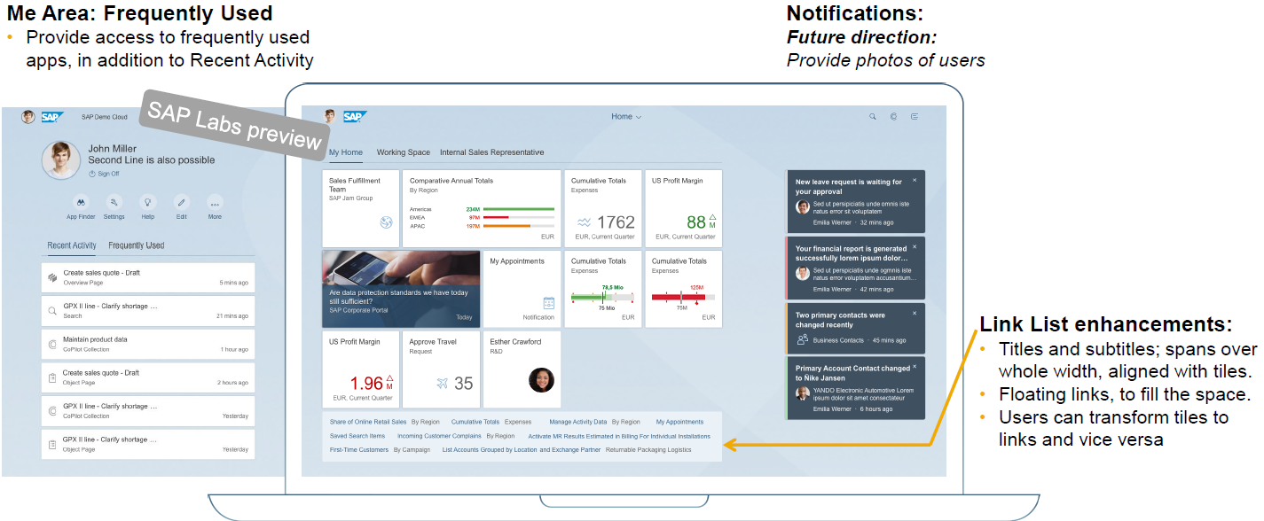
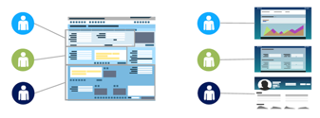
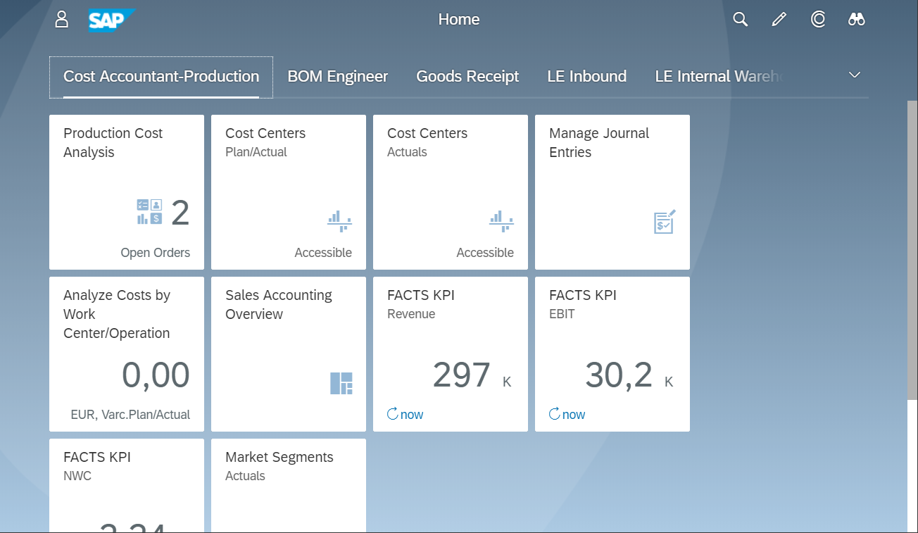
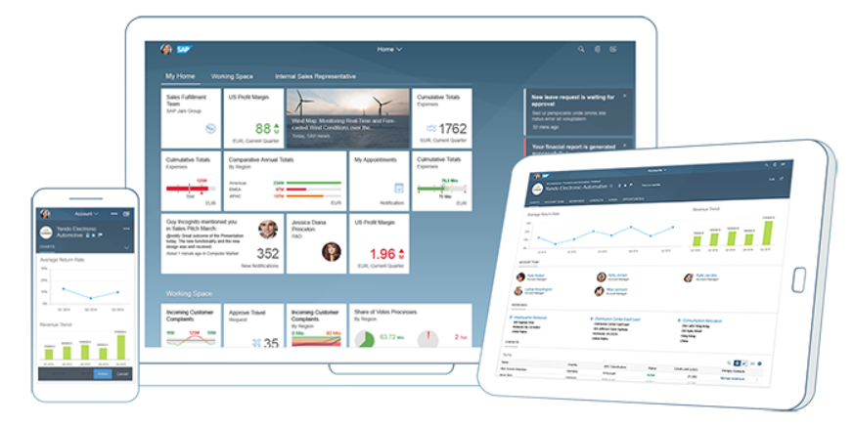
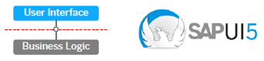
SAP Fiori Launchpad
S/4HANA EXPERIENCE PLATFORM
SAP Fiori Concept
SAP Fiori Launchpad
SAP Fiori Design
SAP Fiori Technology

Slide 14


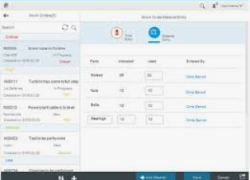
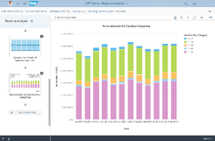
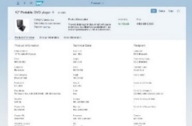
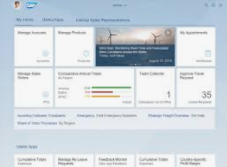
S/4HANA Architecture
Fiori Shell
SAP Fiori UX
Co-Pilot
Fiori Apps
Analytic Apps
Search, Fact Sheets
Dispatcher
oData
oData
oData
SAP S/4HANA
ABAP
SAP S/4HANA Applications
Gateway
Transactional
Analytical
(Enterprise-)Seacrh
CDS Views
Internet
HANA
SAP HANA Database
Database Tables

Slide 15

Questions

